Slide 1
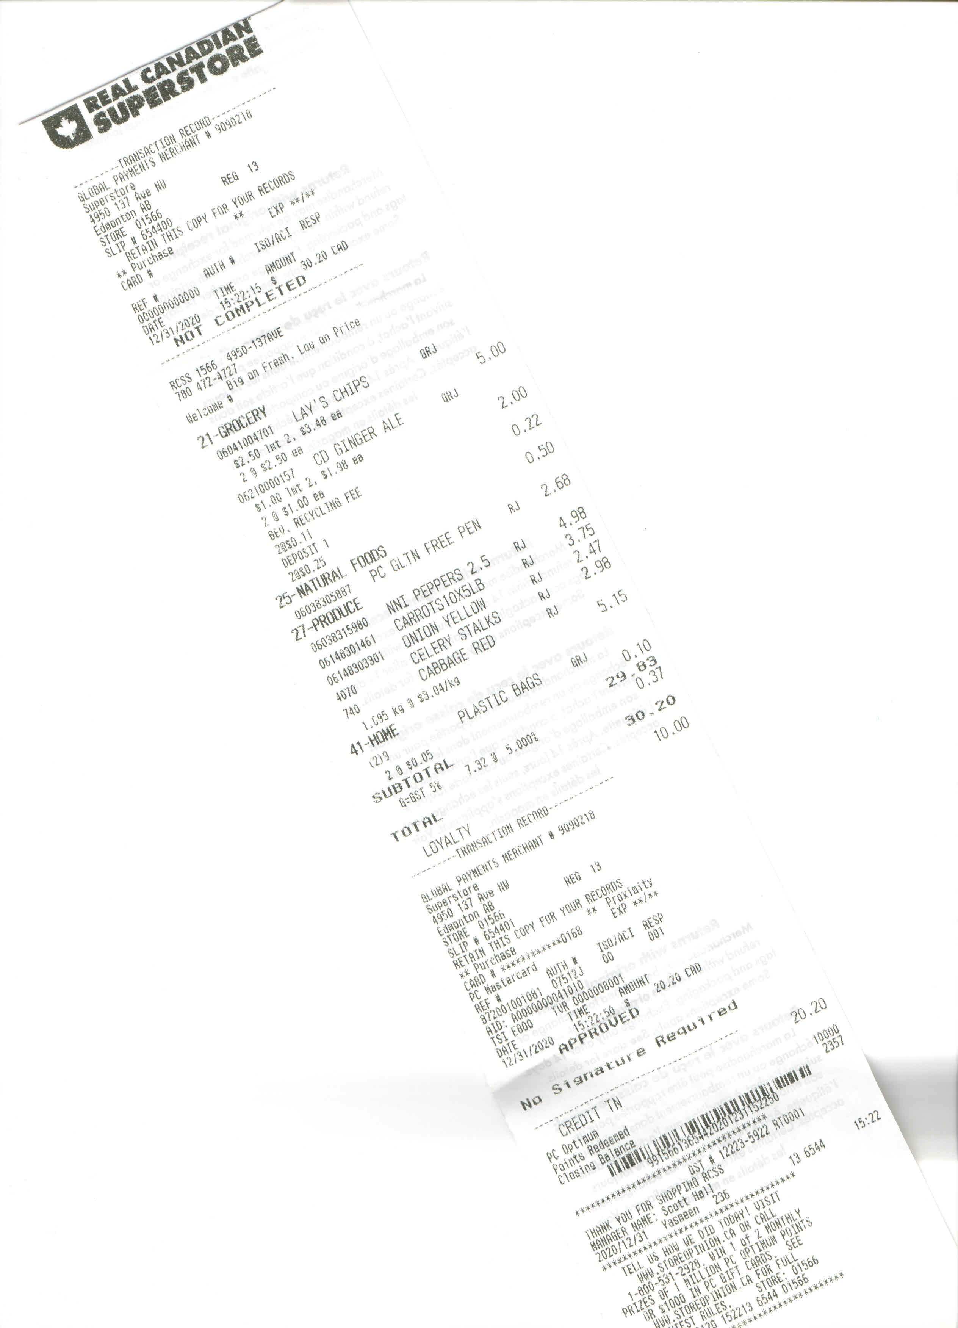
Superstore Receipt
Room 1

Slide 2
Receipt Analysis
Company’s Name – Marketing purposes
Transaction Record – Finance/Accounting, Shipping/Receiving, Sales
Address –– Marketing, Sales

Slide 3
Receipt Analysis
Slogan – Marketing
Loyalty Program (PC Optimum) information – Sales, Marketing
Manager Name/info - Human Resources

Slide 4
Receipt Analysis
Dept # and Name – Sales, Marketing, Shipping/Receiving, Purchasing
Product ID, description, dept code, price - Sales, Marketing, Shipping/Receiving, Purchasing, Finance
Transaction Record – Finance, Sales

Slide 5
Receipt Analysis
Transaction Status – Finance
Loyalty, points – Sales, Finance
Bar code – Sales

Slide 6
Receipt Analysis
GST # - Finance
Manager Name, Cashier Name, Date – Sales, HR
Adds of prizes, gift cards - Marketing

Slide 7
Receipt Analysis
Transaction Record – Marketing, Sales, Finance
Survey – Marketing, Sales
Return Policy – Shipping and Receiving, Sales, Finance

